Slide 1
PoP-ECC: Robust and Flexible Error Correction against Multi-Bit Upsets in DNN Accelerators
Taewon Park†, Saeid Gorgin*, Dongwhee Kim†, Jaeho Shin*, Michael B. Sullivan††, and Jungrae Kim*
†Samsung Electronics, *Sungkyunkwan University, ††NVIDIA

Slide 2
Background & Motivation

Slide 3
DNNs and Errors
Two types of errors
Data errors:
Small noises on the input data
Bit errors:
Random bit flips during storage

Slide 4
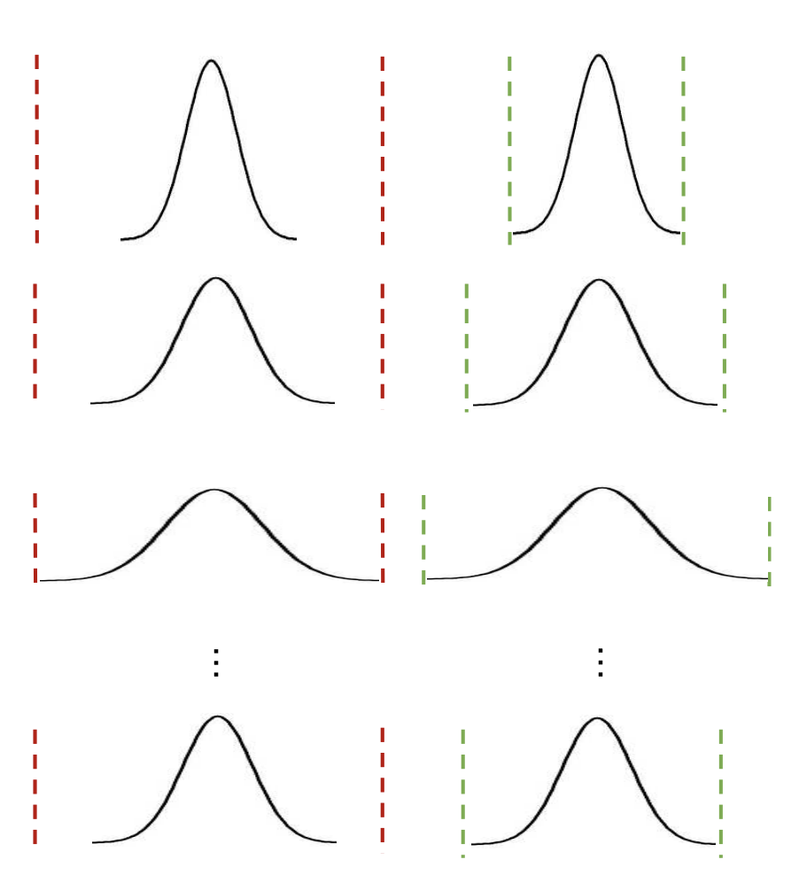
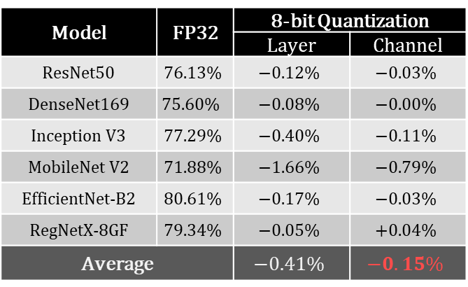
DNNs and Data Errors
DNNs inherently tolerate small data errors, facilitating quantization.
Quantization schemes
Layer-wise vs. channel-wise
Channel-wise quantization provide better accuracy.
Model | FP32 | 8-bit Quantization
 |  | Layer | Channel
ResNet50 | $$76.13\%$$ | $$−0.12\%$$ | $$−0.03\%$$
DenseNet169 | $$75.60\%$$ | $$−0.08\%$$ | $$−0.00\%$$
Inception V3 | $$77.29\%$$ | $$−0.40\%$$ | $$−0.11\%$$
MobileNet V2 | $$71.88\%$$ | $$−1.66\%$$ | $$−0.79\%$$
EfficientNet-B2 | $$80.61\%$$ | $$−0.17\%$$ | $$−0.03\%$$
RegNetX-8GF | $$79.34\%$$ | $$−0.05\%$$ | $$+0.04\%$$
Average |  | $$−0.41\%$$ | $$−0.15\%$$
Layer-wise
Channel-wise
Output: y
Layer N
Filter 1
Layer 2
Filter 2
Layer 1
A comparison of accuracy degradation between layer- and channel-wise quantization (uniform quantization)
Input: x
Filter N
A. Gholami, S. Kim, Z. Dong, Z. Yao, M. W. Mahoney, and K. Keutzer,​ “A survey of quantization methods for efficient neural network inference,” 2021. [Online]. Available: https://arxiv.org/abs/2103.13630​

Slide 5
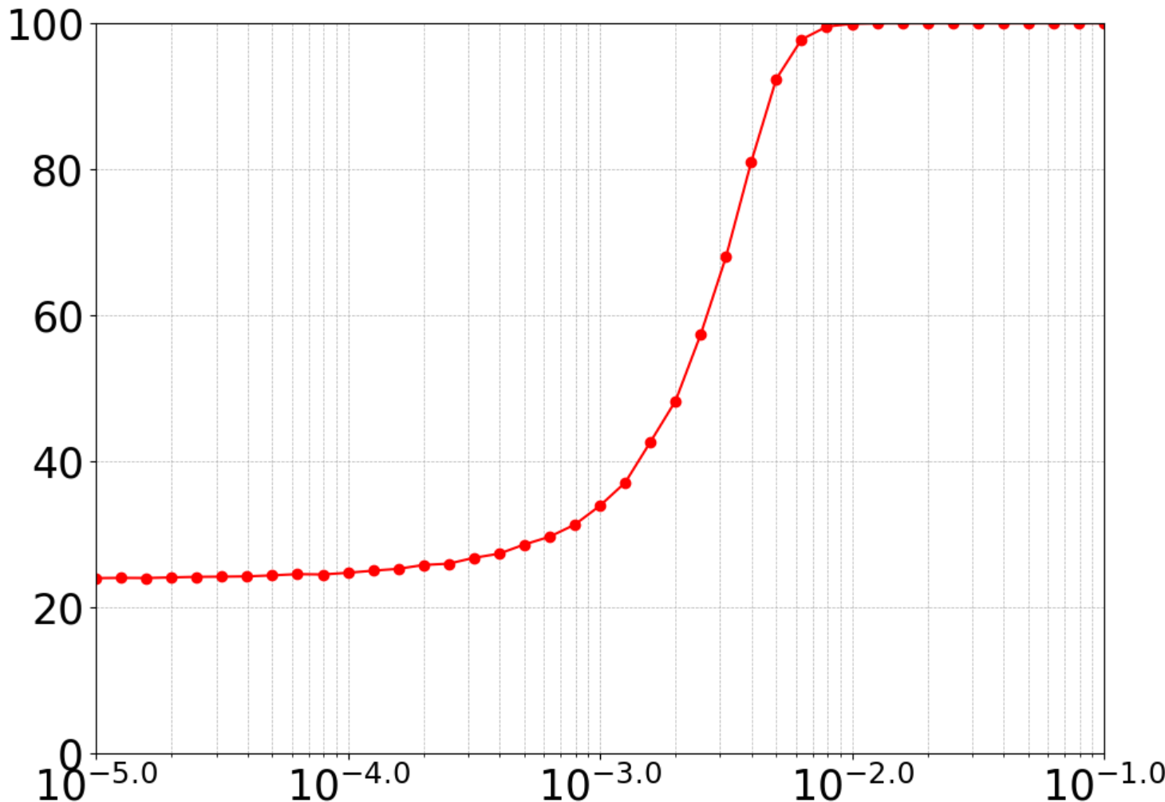
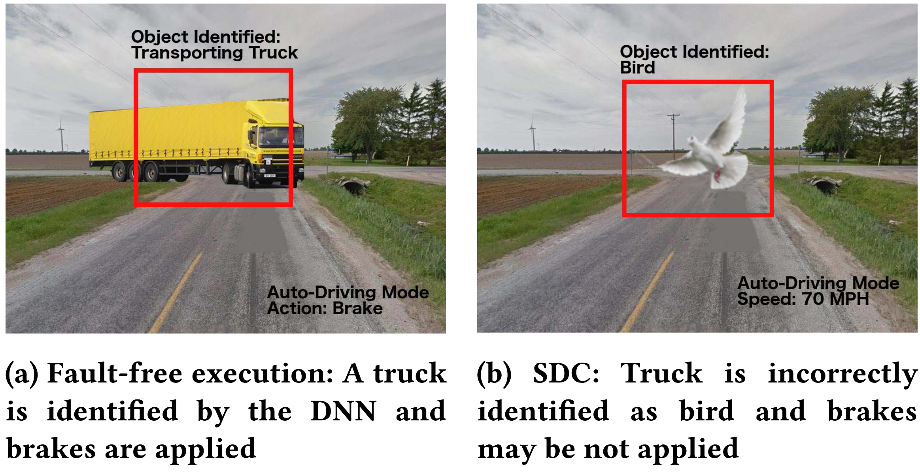
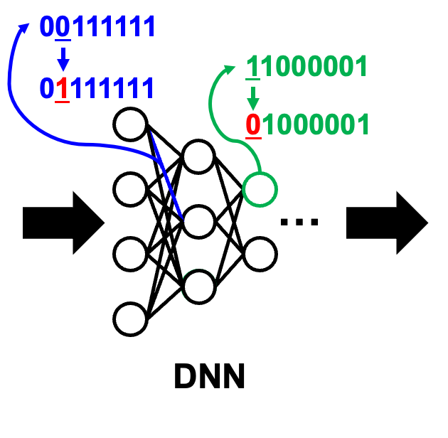
DNNs and Bit Errors
Bit errors on most significant bits affect DNN accuracy by changing the data value significantly.
Classification Error (%)
(No error)
Bit Error Ratio (channel-wise quantization on ResNet50)
G. Li et al., "Understanding Error Propagation in Deep Learning Neural Network (DNN) Accelerators and Applications," SC17: International Conference for High Performance Computing, Networking, Storage and Analysis, 2017, pp. 1-12.

Slide 6
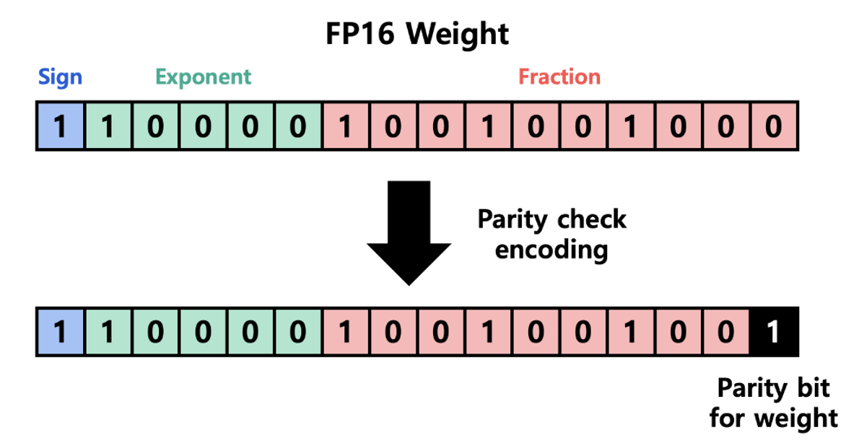
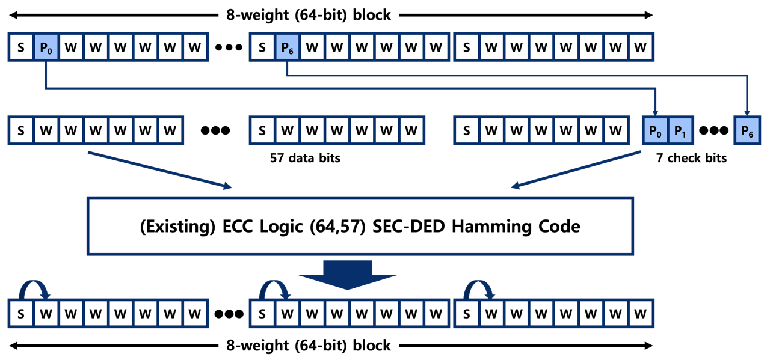
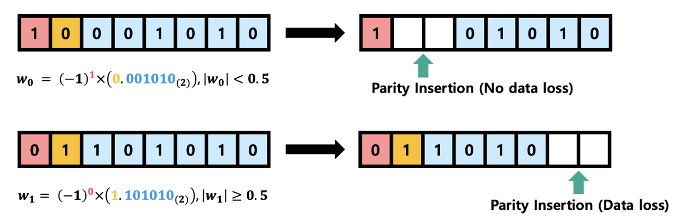
Prior Work on SRAM Protection
Many DNN processors have large SRAMs to store coefficients and activations.
Prior work on SRAM protection:
Weight Nulling [1]
In-place Zero-space ECC [2]
Value-aware Parity Insertion ECC [3]
Weight Nulling
In-place Zero-space
Value-aware Parity Insertion ECC
[1] M. Qin et al., “Robustness of Neural Networks against Storage Media Errors,” 2017. (https://arxiv.org/abs/1709.06173)
[2] H. Guan et al., “In-place zero-space memory protection for CNN,” (NIPS), 2019.
[3] S.-S. Lee and J.-S. Yang, “Value-Aware Parity Insertion ECC for Fault Tolerant Deep Neural Network,” (DATE), 2022.

Slide 7
Prior Work on SRAM Protection
Many DNN processors have large SRAMs to store coefficients and activations.
Prior work on SRAM protection:
Weight Nulling [1]
In-place Zero-space ECC [2]
Value-aware Parity Insertion ECC [3]
Mostly can correct single-bit errors!
Weight Nulling
In-place Zero-space
Value-aware Parity Insertion ECC
[1] M. Qin et al., “Robustness of Neural Networks against Storage Media Errors,” 2017. (https://arxiv.org/abs/1709.06173)
[2] H. Guan et al., “In-place zero-space memory protection for CNN,” (NIPS), 2019.
[3] S.-S. Lee and J.-S. Yang, “Value-Aware Parity Insertion ECC for Fault Tolerant Deep Neural Network,” (DATE), 2022.

Slide 8

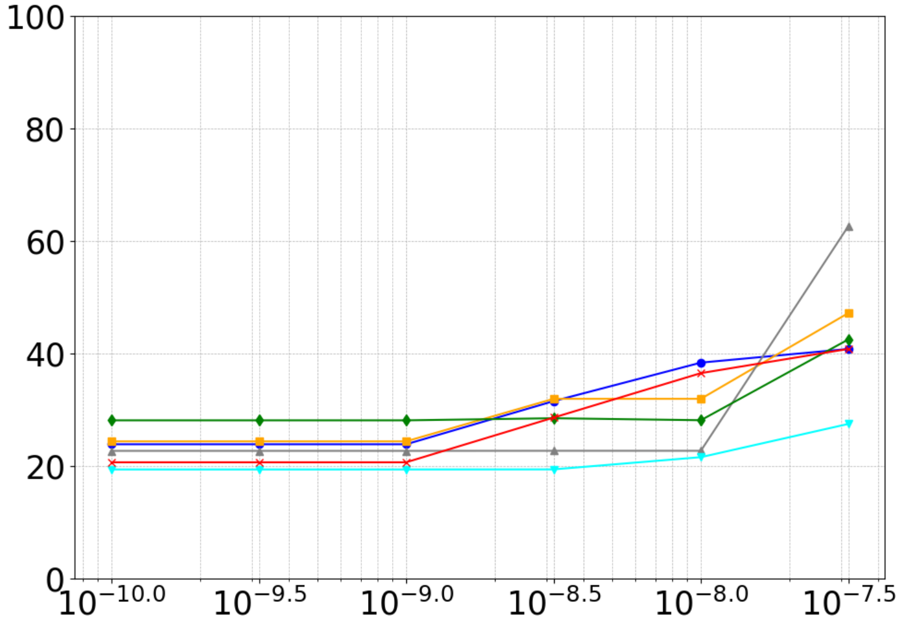
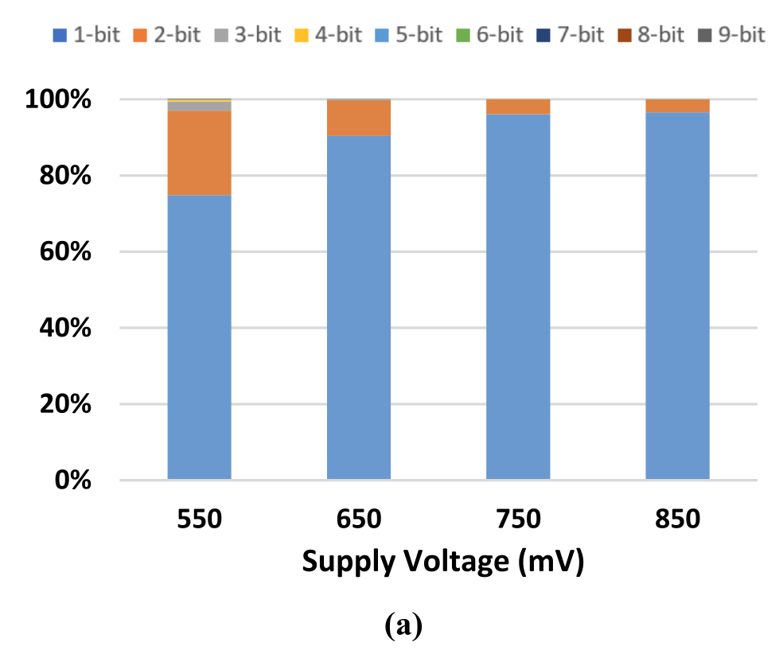
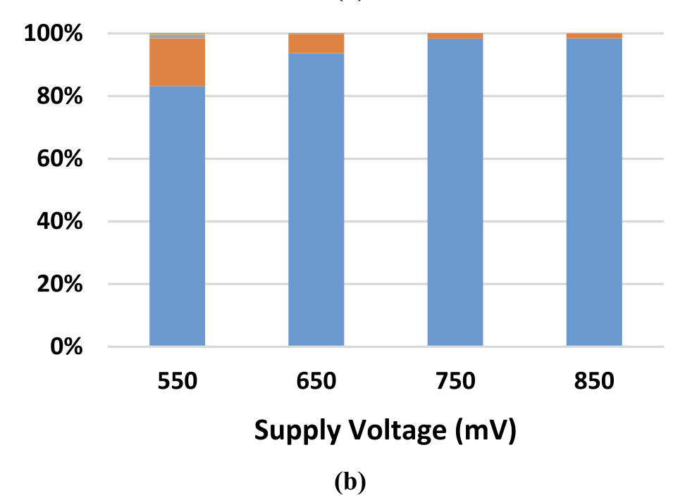
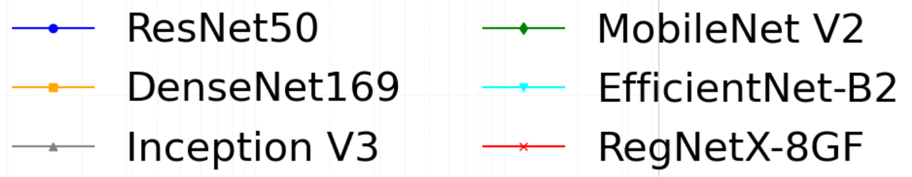

Prior Work on SRAM Protection
However, technology scaling and lower supply voltage raise Multi Cell Upset (MCU) rates in SRAM.
Multi Cell Upset rate
Classification Error (%)
SP SRAM
TP SRAM
Supply Voltage($mV$)
(No error)
Double Adjacent Error Ratio

Slide 9
Prior Work on SRAM Protection
However, technology scaling and lower supply voltage raise Multi Cell Upset (MCU) rates in SRAM.
This necessitates utilizing an mechanism to correct MCUs.
Multi Cell Upset rate
Classification Error (%)
SP SRAM
TP SRAM
Supply Voltage($mV$)
(No error)
Double Adjacent Error Ratio

Slide 10
Error Correction Codes (ECC)
A common solution to DNN reliability is using ECC.
ECC Encoder
Data
Data
Parity
Parity

Slide 11
Error Correction Codes (ECC)
A common solution to DNN reliability is using ECC.
ECC Encoder
Data
Data
Parity
Parity
ECC Decoder
Data
Corrupted Data
Parity

Slide 12
Error Correction Codes (ECC)
A common solution to DNN reliability is using ECC.
However, the large SRAMs in DNN accelerators make the 12.5% ECC overhead costly, while offering limited protection against MCUs.
ECC Encoder
Data
Data
Parity
Parity
ECC Decoder
Data
Corrupted Data
Parity

Slide 13
Error Correction Codes (ECC)
A common solution to DNN reliability is using ECC.
However, the large SRAMs in DNN accelerators make the 12.5% ECC overhead costly, while offering limited protection against MCUs.
ECC Encoder
A novel scheme is required to reduce redundancy and provide strong memory protection for target MCUs.
Data
Data
Parity
Parity
ECC Decoder
Data
Corrupted Data
Parity

Slide 14
Parities of Parities ECC (PoP-ECC)

Slide 15
PoP-ECC
PoP-ECC is a strong and flexible two-level ECC scheme to prevent severe memory errors.
First level: extracts Virtual Parities (VPs) from the weights.
W0
W1
W7
A block with 8 weights

Slide 16
PoP-ECC
PoP-ECC is a strong and flexible two-level ECC scheme to prevent severe memory errors.
First level: extracts Virtual Parities (VPs) from the weights.
W0
W1
W7
1st-level ECC encoding
VP0
VP1
VP7

Slide 17
PoP-ECC
PoP-ECC is a strong and flexible two-level ECC scheme to prevent severe memory errors.
First level: extracts Virtual Parities (VPs) from the weights.
Second level: protects VPs using Parities of Parities (PPs) via RS encoding.
W0
W1
W7
1st-level ECC encoding
2nd-level ECC encoding
VP0
VP1
VP7
PP0
PP1
PP2
PP3

Slide 18
PoP-ECC
PoP-ECC is a strong and flexible two-level ECC scheme to prevent severe memory errors.
First level: extracts Virtual Parities (VPs) from the weights.
Second level: protects VPs using Parities of Parities (PPs) via RS encoding.
W0
W1
W7
1st-level ECC encoding
Encoding
2nd-level ECC encoding
VP0
VP1
VP7
W0
W1
W7
PP0
PP1
PP2
PP3

Slide 19
PoP-ECC
PoP-ECC is a strong and flexible two-level ECC scheme to prevent severe memory errors.
First level: extracts Virtual Parities (VPs) from the weights.
Second level: protects VPs using Parities of Parities (PPs) via RS encoding.
W0
W1
W7
1st-level ECC encoding
Encoding
2nd-level ECC encoding
VP0
VP1
VP7
W0
W1
W7
PP0
PP1
PP2
PP3
VP0
VP1
VP7
PP0
PP1
PP2
PP3
1st-level ECC encoding

Slide 20
PoP-ECC
PoP-ECC is a strong and flexible two-level ECC scheme to prevent severe memory errors.
First level: extracts Virtual Parities (VPs) from the weights.
Second level: protects VPs using Parities of Parities (PPs) via RS encoding.
W0
W1
W7
1st-level ECC encoding
Encoding
2nd-level ECC encoding
VP0
VP1
VP7
W0
W1
W7
PP0
PP1
PP2
PP3
VP0
VP1
VP7
PP0
PP1
PP2
PP3
VP0
VP1
VP7
1st-level ECC encoding
2nd-level ECC decoding

Slide 21
PoP-ECC
PoP-ECC is a strong and flexible two-level ECC scheme to prevent severe memory errors.
First level: extracts Virtual Parities (VPs) from the weights.
Second level: protects VPs using Parities of Parities (PPs) via RS encoding.
W0
W1
W7
1st-level ECC encoding
Encoding
2nd-level ECC encoding
VP0
VP1
VP7
W0
W1
W7
PP0
PP1
PP2
PP3
VP0
VP1
VP7
PP0
PP1
PP2
PP3
VP0
VP1
VP7
1st-level ECC encoding
1st-level ECC decoding
W0
W1
W7
2nd-level ECC decoding

Slide 22
PoP-ECC
PoP-ECC is a strong and flexible two-level ECC scheme to prevent severe memory errors.
First level: extracts Virtual Parities (VPs) from the weights.
Second level: protects VPs using Parities of Parities (PPs) via RS encoding.
W0
W1
W7
1st-level ECC encoding
Encoding
2nd-level ECC encoding
VP0
VP1
VP7
W0
W1
W7
PP0
PP1
PP2
PP3
VP0
VP1
VP7
PP0
PP1
PP2
PP3
Decoding
VP0
VP1
VP7
1st-level ECC encoding
1st-level ECC decoding
W0
W1
W7
2nd-level ECC decoding

Slide 23
PoP-ECC
PoP-ECC is a strong and flexible two-level ECC scheme to prevent severe memory errors.
First level: extracts Virtual Parities (VPs) from the weights.
Second level: protects VPs using Parities of Parities (PPs) via RS encoding.
Extracting a VP from raw data can be customized to the target MCUs.
PoP-ECC operates efficiently across various precisions and sizes.
W0
W1
W7
1st-level ECC encoding
Encoding
2nd-level ECC encoding
VP0
VP1
VP7
W0
W1
W7
PP0
PP1
PP2
PP3
VP0
VP1
VP7
PP0
PP1
PP2
PP3
Decoding
VP0
VP1
VP7
1st-level ECC encoding
1st-level ECC decoding
W0
W1
W7
2nd-level ECC decoding

Slide 24
Quantization & PoP-ECC (Q+PoP)

Slide 25
Q+PoP
Q+PoP combines the high accuracy of channel-wise quantization with the robustness of PoP-ECC without extra SRAM for ECC redundancy.
Quantization (Channel-wise)
Q+PoP
PoP-ECC (strong & flexible )

Slide 26
Q+PoP encoding process
Without loss of generality, Q+PoP reduces FP32 to INT6 using channel-wise quantization.
W0
W1
W7
Trained FP32 Weight

Slide 27
Q+PoP encoding process
Without loss of generality, Q+PoP reduces FP32 to INT6 using channel-wise quantization.
W0
W1
W7
Trained FP32 Weight
6b
6b
6b
Channel-wise Quantization
W0
W1
W7
Quantized Weight

Slide 28
Q+PoP encoding process
In the first stage, a 4-bit Virutual Parity (VP) is generated from the 6-bit weight.
The generated 4-bit VP is designed to correct all single- and double-bit errors in the upper 5-bits of the quantized weight.
In the second stage, PoP-ECC utilizes RS code to protect VPs on a symbol basis.
Q+PoP applies 4-bit RS encoding to the eight VPs to generate 4 PPs.
W0
W1
W7
Trained FP32 Weight
6b
6b
6b
Channel-wise Quantization
W0
W1
W7
Quantized Weight
1st-level ECC encoding
VP0
VP1
VP7
Virtual Parity
2nd-level ECC encoding
4b
4b
4b
W0
W1
W7
PP0
PP1
PP2
PP3
Parity of Parity
6b
6b
6b
4b
4b
4b
4b

Slide 29
Q+PoP decoding process
On receiving the erroneous block, PoP-ECC first regenerates VPs using the same generator matrix as the encoding.
6b
6b
6b
4b
4b
4b
4b
W0
W1`
W7`
PP0
PP1
PP2
PP3

Slide 30
Q+PoP decoding process
(12, 8) RS code decoding can correct two erroneous 4-bit VPs with four 4-bit PPs.
After restoring the VPs, PoP-ECC utilizes the VPs to restore the weights.
6b
6b
6b
4b
4b
4b
4b
W0
W1`
W7`
PP0
PP1
PP2
PP3
VP0
VP1'
VP7'
PP0
PP1
PP2
PP3
VP0
VP1
VP7
1st-level ECC encoding
2nd-level ECC decoding
W0
W1
W7
1st-level ECC decoding
6b
6b
6b

Slide 31
Evaluation

Slide 32
Evaluation
We implemented WN, VAPI, and Q+PoP in the PyTorch framework.
Methodology
Mem. protection schemes | DNN Models | Error Injection | Input dataset | Error ratios
WN VAPI Q+PoP | ResNet50 DesneNet169 Inception V3 MobileNet V2 EfficientNet-B2 RegNetX-8GF | SE (Single Error) DAE (Double Adjacent Error) | ISLVRC-2012 (50,000 validation images) | 10⁻⁵ to 10⁻¹

Slide 33
Evaluation
We implemented WN, VAPI, and Q+PoP in the PyTorch framework.
Methodology
Mem. protection schemes | DNN Models | Error Injection | Input dataset | Error ratios
WN VAPI Q+PoP | ResNet50 DesneNet169 Inception V3 MobileNet V2 EfficientNet-B2 RegNetX-8GF | SE (Single Error) DAE (Double Adjacent Error) | ISLVRC-2012 (50,000 validation images) | 10⁻⁵ to 10⁻¹
Accuracy
Accuracy without errors (shows the impact of quantization)
Reliability
Accuracy with errors
Hardware overheads

Slide 34

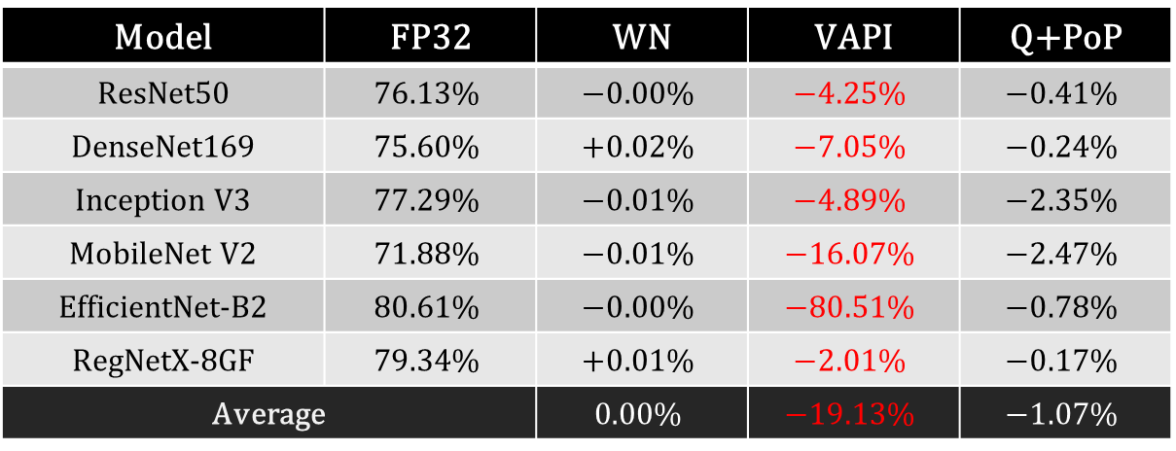
Base Top-1 classification Accuracy
Q+PoP shows an average of $−$1.07% degradation.
Model | FP32 | WN | VAPI | Q+PoP
ResNet50 | $$76.13\%$$ | $$−0.00\%$$ | $$−4.25\%$$ | $$−0.41\%$$
DenseNet169 | $$75.60\%$$ | $$+0.02\%$$ | $$−7.05\%$$ | $$−0.24\%$$
Inception V3 | $$77.29\%$$ | $$−0.01\%$$ | $$−4.89\%$$ | $$−2.35\%$$
MobileNet V2 | $$71.88\%$$ | $$−0.01\%$$ | $$−16.07\%$$ | $$−2.47\%$$
EfficientNet-B2 | $$80.61\%$$ | $$−0.00\%$$ | $$−80.51\%$$ | $$−0.78\%$$
RegNetX-8GF | $$79.34\%$$ | $$+0.01\%$$ | $$−2.01\%$$ | $$−0.17\%$$
Average |  | $$0.00\%$$ | $$−19.13\%$$ | $$−1.07\%$$
WN provides almost the same accuracy as the pretrained FP32 weights.
VAPI sacrifices accuracy significantly (up to 80.51%) in our evaluation.

Slide 35

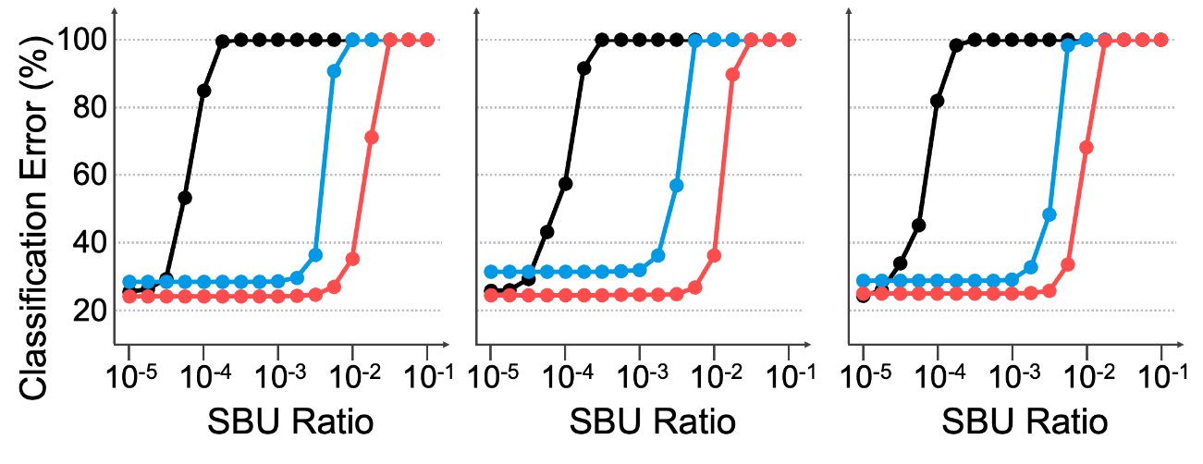
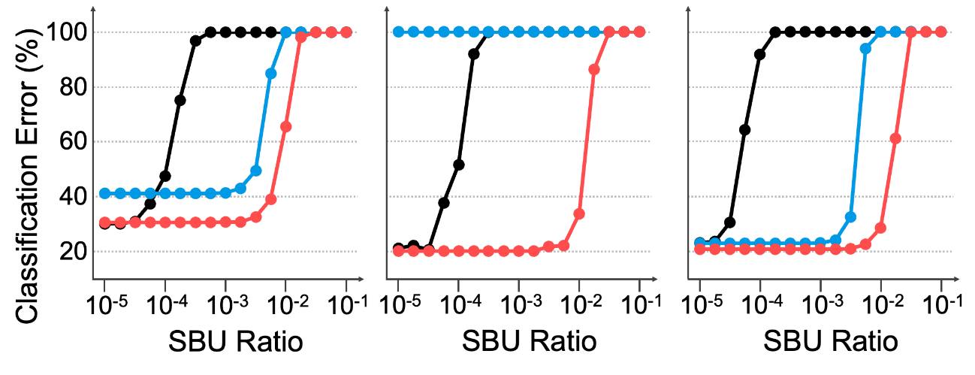
Reliability against Single-Errors
Q+PoP can provide higher accuracy than VAPI, for lower SBUs (< 10⁻⁵).
Q+PoP can tolerate the highest BER of up to near 3x10⁻³.
(No error)
(a) ResNet50
(b) Densenet169
(c) Inception V3
(d) MobileNet V2
(e) EfficientNet-B2
(f) RegNetX-8GF
The accuracy of WN decreases quickly as the ratio approaches 10⁻⁴.

Slide 36
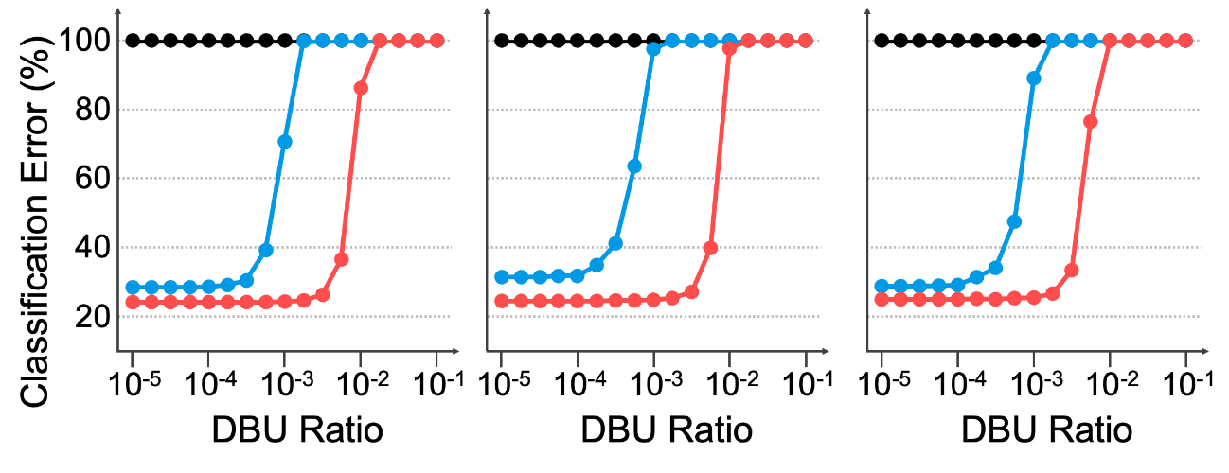
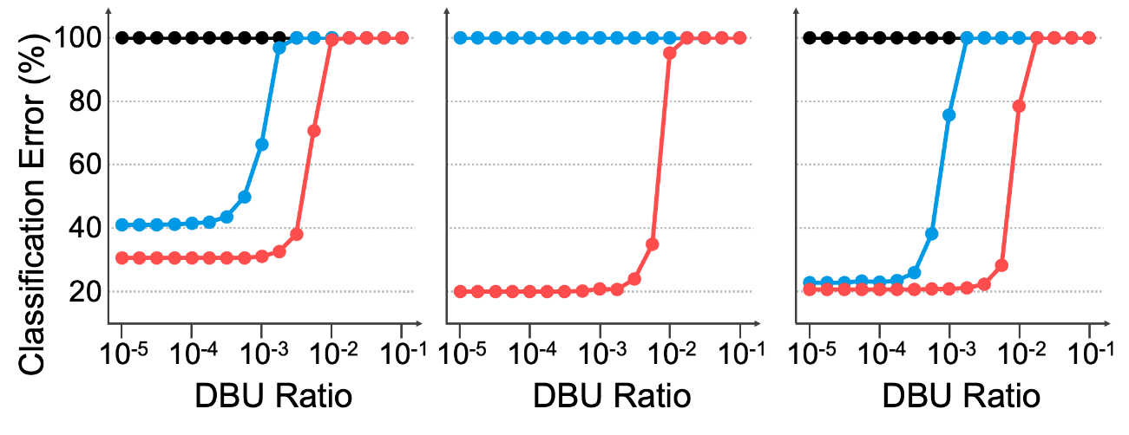
Reliability against Double-Adjacent Errors
Q+PoP can tolerate:
up to 10⁻³ by correcting up to two DAEs within a 64-bit block.
up to 31.62x higher *maximum DAE ratio than VAPI.
(No error)
(a) ResNet50
(b) Densenet169
(c) Inception V3
(d) MobileNet V2
(e) EfficientNet-B2
(f) RegNetX-8GF
* Maximum DAE ratio is that which does not reduce DNN accuracy by 0.1 percentage point than error-free cases.
WN cannot detect double-bit errors within a weight even at lower DBUs (<10⁻⁵).
At 10⁻³, VAPI cannot protect DNN accuracy.

Slide 37
Hardware Costs
Synthesis Set-up
Compiler : Synopsys design compiler
Logic libraries : UMC 28nm SVT library.
Hardware Cost | Speed | Area | Power
PoP-ECC Encoder | 0.65ns | 92um² (0.3K NAND2 gates) | 0.08mW
PoP-ECC Decoder | 1.56ns | 1760um² (6K NAND2 gates) | 1.2mW

Slide 38
Conclusion

Slide 39
Conclusion
Technology scaling => Rising soft error rates “Multi-Cell Upsets (MCUs) now common”
Up to 31.62× better DAE tolerance Higher accuracy with negligible delay, area, and power cost

Slide 40
Conclusion
Technology scaling => Rising soft error rates “Multi-Cell Upsets (MCUs) now common”
Our Solution – PoP-ECC Robust and flexible Two-level ECC: Virtual Parities + Parities of Parities Effectively mitigates MCUs with minimal overhead
p to 31.62× better DAE tolerance Higher accuracy with negligible delay, area, and power cost

Slide 41
Conclusion
Technology scaling => Rising soft error rates “Multi-Cell Upsets (MCUs) now common”
Our Solution – PoP-ECC Robust and flexible Two-level ECC: Virtual Parities + Parities of Parities Effectively mitigates MCUs with minimal overhead
Q+PoP Combines PoP-ECC + Channel-wise quantization Tailored for efficient DNN protection
Up to 31.62× better DAE tolerance Higher accuracy with negligible delay, area, and power cost

Slide 42
Conclusion
Technology scaling => Rising soft error rates “Multi-Cell Upsets (MCUs) now common”
Our Solution – PoP-ECC Robust and flexible Two-level ECC: Virtual Parities + Parities of Parities Effectively mitigates MCUs with minimal overhead
Q+PoP Combines PoP-ECC + Channel-wise quantization Tailored for efficient DNN protection
Up to 31.62× better DAE tolerance Higher accuracy with negligible delay, area, and power cost

Slide 43


